Slide 1
DBMS

Slide 2
What is Database Management System?
Database Management Systems (DBMS) are software systems used to store, retrieve, and run queries on data.
A DBMS serves as an interface between an end-user and a database, allowing users to create, read, update, and delete data in the database.
Some DBMS examples include MySQL, PostgreSQL, Microsoft Access, SQL Server, FileMaker, Oracle, RDBMS.

Slide 3
The goal of a DBMS is to provide an environment that is both convenient and efficient to use in :
Retrieving information from the database.
Storing information into the database

Slide 4
DBMS Used For
Data independence and efficient access.
Reduced application development time.
Data integrity and security.
Uniform data administration.
Concurrent access, recovery from crashes.

Slide 5
Need For DBMS
Processing Queries and Object Management.
2) Controlling redundancy and inconsistency.
3) Efficient memory management and indexing.
4) Concurrency control and transaction management.
5) Access Control and ease in accessing data.
6) Integrity constraints.

Slide 6
Data models

Slide 7
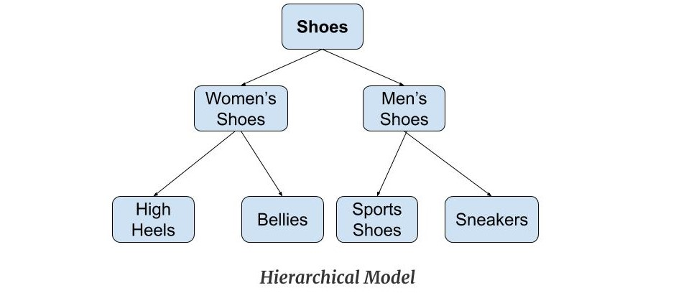
Hierarchical Model
The hierarchy starts from the root which has root data and then it expands in the form of a tree adding child node to the parent node.
One-to-many relationship: .
Parent-Child Relationship
Deletion Problem:
Pointers:

Slide 8
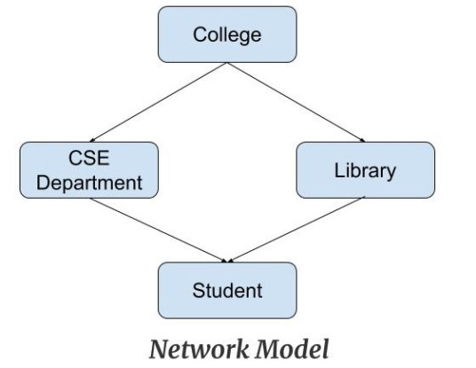
Network Model
A record can have more than one parent. It replaces the hierarchical tree with a graph.
Ability to Merge more Relationships:
Many paths:
Circular Linked List:

Slide 9
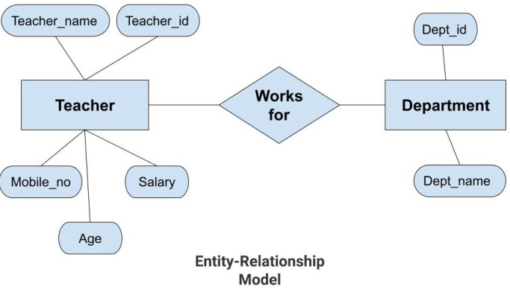
Entity-Relationship Model
Entity-Relationship Model or simply ER Model is a high-level data model diagram
Graphical Representation for
Better Understanding:
ER Diagram:
Database Design:

Slide 10
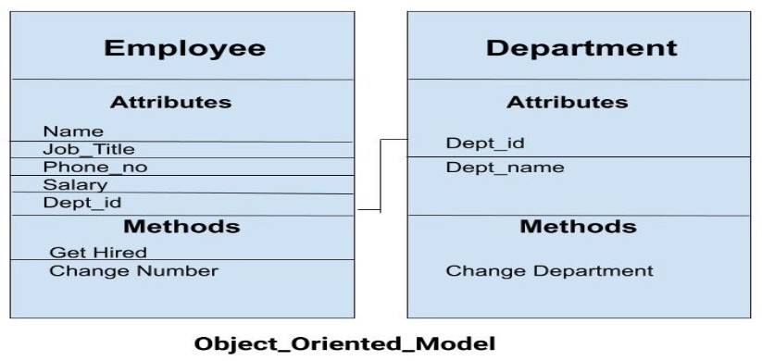
Object-Oriented Model
Object DBMSs add database functionality to object programming languages. They bring much more than persistent storage of programming language objects.

Slide 11
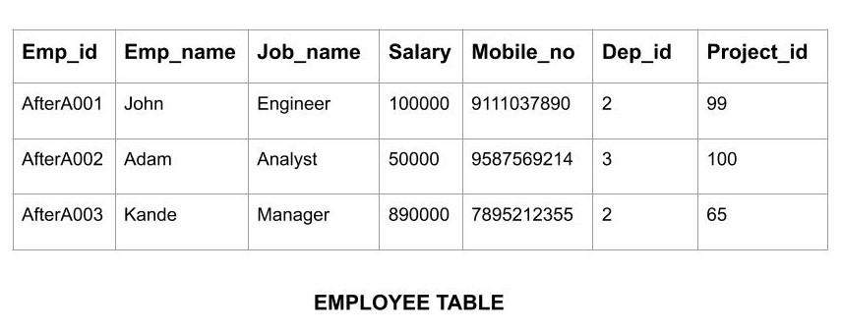
Relational Model
(RDBMS - relational database management system) A database based on the relational model developed by E.F. Code.
In such a database the data and relations between them are organized in tables. A table is a collection of records and each record in a table contains the same fields.

Slide 12
Properties of Relational Tables
Values are atomic.
All of the values in a column have the same data type.
Each row is unique.
The sequence of columns is insignificant.
The sequence of rows is insignificant.
Each column has a unique name.
Integrity constraints maintain data consistency across multiple tables.

Slide 13
Advantages of DBMS
1. Data Integrity
2. Data Security
3. Better data integration
4. Minimized Data Inconsistency
5. Faster Data Access
6. Recovery and Backup
7. Increased end-user productivity
8. Simplicity

Slide 14
Disadvantages of DBMS
Cost of Hardware and Software
Cost of Data Conversion
Cost of Staff Training
Appointing Technical Staff
Database Damage

Slide 15
SQL Constraints
Constraints are the rules enforced on data columns on table.
These are used to limit the type of data that can go into a table.
This ensures the accuracy and reliability of the data in the database.
NOT NULL - Ensures that a column cannot have a NULL value
UNIQUE - Ensures that all values in a column are different
CHECK - Ensures that the values in a column satisfies a specific condition
DEFAULT - Sets a default value for a column if no value is specified
CREATE INDEX - Used to create and retrieve data from the database very quickly

Slide 16
DATA TYPES
Numeric data types : such as int, tinyint, bigint, float, real, etc.
Date and Time data types : such as Date, Time, Datetime, etc.
Character and String data types : such as char, varchar, text, etc.
Unicode character string data types, for example nchar, nvarchar, ntext, etc.
Binary data types such as binary, varbinary, etc.

Slide 17
DBMS Keys
KEYS in DBMS is an attribute or set of attributes which helps you to identify a row(tuple) in a relation(table). They allow you to find the relation between two tables
Why we need a Key?
Keys help you to identify any row of data in a table.
Allows you to establish a relationship between and identify the relation between tables
Help you to enforce identity and integrity in the relationship.

Slide 18
DBMS Keys
Super Key – A super key is a group of single or multiple keys which identifies rows in a table.
Primary Key – is a column or group of columns in a table that uniquely identify every row in that table.
Candidate Key – is a set of attributes that uniquely identify tuples in a table. Candidate Key is a super key with no repeated attributes.

Slide 19
DBMS Keys
Alternate Key – is a column or group of columns in a table that uniquely identify every row in that table.
Foreign Key – is a column that creates a relationship between two tables. The purpose of Foreign keys is to maintain data integrity and allow navigation between two different instances of an entity.

Slide 20
SQL

Slide 21
SQL is Structured Query Language, which is a computer language for storing, manipulating and retrieving data stored in relational database.
SQL is the standard language for Relation Database System.
All relational database management systems like MySQL, MS Access, Oracle, Sybase, Informix, postgres and SQL Server use SQL as standard database language.

Slide 22
SQL Commands:
The standard SQL commands to interact with relational databases are CREATE, SELECT, INSERT, UPDATE, DELETE and DROP.
These commands can be classified into groups based on their nature:

Slide 23
DDL -Data Definition Language
SQL uses the following set of commands to define the structure of database.
Command | Description
CREATE | Creates a new table, a view of a table, or other object in database
ALTER | Modifies an existing database object, such as a table.
DROP | Deletes an entire table, a view of a table or other object in the database.

Slide 24
DDL -Data Definition Language
The CREATE statement is used to create a database or a table.
Syntax
CREATE DATABASE dbname;
CREATE TABLE table_name ( column_name1 data_type(size), column_name2 data_type(size), column_name3 data_type(size), .... );

Slide 25
DDL -Data Definition Language
Eg:-
CREATE DATABASE mydb;
Eg;-
CREATE TABLE Persons ( PersonID int(150), LastName varchar(255), FirstName varchar(255), Address text, City varchar(255) );

Slide 26
DDL -Data Definition Language
DROP
Drops commands, views, tables, and databases from RDBMS.
Syntax
Drop database databasename;
Drop table tablename;

Slide 27
DDL -Data Definition Language
ALTER
Modifies database schema.
Syntax:
ALTER TABLE table_name {ADD|DROP|MODIFY} column_name {data_ype};
ALTER TABLE table_name RENAME TO new_table_name;
Eg:-
Alter table article add subject varchar;

Slide 28
DML -Data Manipulation Language
SQL is equipped with data manipulation language (DML).
DML modifies the database instance by inserting, updating, and deleting its data.

Slide 29
DML -Data Manipulation Language
Command | Description
INSERT | Creates a record
UPDATE | Modifies records
DELETE | Deletes records
SELECT | Retrieve Records

Slide 30
DML -Data Manipulation Language
SQL INSERT Query
The SQL INSERT INTO Statement is used to add new rows of data to a table in the database.
Syntax:
INSERT INTO TABLE_NAME (column1, column2, column3,...columnN)] VALUES (value1, value2, value3,...valueN);
INSERT INTO TABLE_NAME VALUES (value1,value2,value3,...valueN);

Slide 31
DML -Data Manipulation Language
SQL SELECT Query
Used to fetch the data from a database table which returns data in the form of result table (called result-sets).
Syntax:
SELECT column1, column2, columnN FROM table_name;
SELECT column1, column2, columnN FROM table_name WHERE [condition]

Slide 32
DML -Data Manipulation Language
SQL WHERE Clause
The SQL WHERE clause is used to specify a condition while fetching the data from single table or joining with multiple tables.
If the given condition is satisfied, then only it returns specific value from the table.

Slide 33
DML -Data Manipulation Language
SQL UPDATE Query
The SQL UPDATE Query is used to modify the existing records in a table.
Syntax:
UPDATE table_name SET column1 = value1, column2 = value2...., columnN = valueN
WHERE [condition];

Slide 34
DML -Data Manipulation Language
SQL DELETE Query
The SQL DELETE Query is used to delete the existing records from a table.
Syntax:
DELETE FROM table_name WHERE [condition];
Eg:-
DELETE FROM CUSTOMERS WHERE ID = 6;

Slide 35
Aggregate Functions [and performance scaling]
Aggregate functions are those functions in the DBMS which takes the values of multiple rows of a single column and then form a single value by using a query.
Following are the five aggregate functions:
1. AVG
2. COUNT
3. SUM
4. MIN
5. MAX

Slide 36
Aggregate Functions [and performance scaling]
AVG Function
This function takes the values from the given column and then returns the average of the values
Eg:
Select AVG (Emp_salary) from Employee_Details ;

Slide 37
Aggregate Functions [and performance scaling]
COUNT Function
This aggregate function returns the total number of values in the specified column.
Eg:
Select COUNT (Emp_salary) from Employee_Details ;

Slide 38
Aggregate Functions [and performance scaling]
SUM Function
This aggregate function sums all the non-NULL values of the given column.
Eg
Select SUM (Emp_salary) from Employee_Details ;

Slide 39
Aggregate Functions [and performance scaling]
MAX Function
This function returns the value, which is maximum from the specified column.
Eg
Select MAX (Emp_salary) from Employee_Details ;

Slide 40
Aggregate Functions [and performance scaling]
MIN Function
This function returns the value, which is minimum from the specified column.
Eg:
Select MIN (Emp_salary) from Employee_Details ;

Slide 41
Aggregate Enhancers [order by/ group by/ having]
The use of ORDER BY/ GROUP BY are closely related to the use of aggregate functions and the HAVING statement.
The ORDER BY clause’s purpose is to sort the query result by specific columns.
The GROUP BY clause’s purpose is summarize unique combinations of columns values.

Slide 42
Aggregate Enhancers [order by/ group by/ having]
ORDER BY Clause
ORDER BY clause allows sorting the output values.
By default, the ascending (ASC) sorting is applied. For the sorting to be descending, an additional DESC clause is used.
SELECT column1, column2, columnN FROM table_name
ORDER BY column1, column2, columnN ASC | DESC;

Slide 43
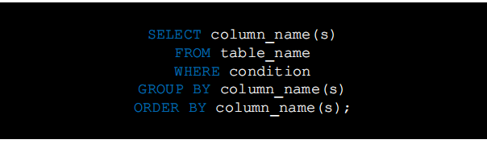
Aggregate Enhancers [order by/ group by/ having]
GROUP BY Clause
GROUP BY clause used to combine the selection results by one or more columns.
After grouping, there will be only one entry for each value used in the column.

Slide 44

Aggregate Enhancers [order by/ group by/ having]
HAVING Clause
HAVING is a filtering tool. It indicates the result of aggregate functions performance.
The HAVING clause is used when we cannot use the WHERE keyword, i.e., with aggregate functions.
.

Slide 45
Handling Duplicates
The SQL DISTINCT keyword is used in conjunction with SELECT statement to eliminate all the duplicate records and fetching only unique records.
Syntax:
SELECT DISTINCT column1, column2,.....columnN FROM table_name WHERE [condition]
EG:
SELECT DISTINCT SALARY FROM CUSTOMERS ORDER BY SALARY;

Slide 46
Data Normalization [and its usages]
Normalization is a database design technique that reduces data redundancy and eliminates undesirable characteristics like Insertion, Update and Deletion Anomalies.
Normalization rules divides larger tables into smaller tables and links them using relationships.
The purpose of Normalisation in SQL is to eliminate redundant (repetitive) data and ensure data is stored logically.
Here is a list of Normal Forms in SQL:

Slide 47
Data Normalization [and its usages]
◆ 1NF (First Normal Form)
◆ 2NF (Second Normal Form)
◆ 3NF (Third Normal Form)
◆ BCNF (Boyce-Codd Normal Form)
◆ 4NF (Fourth Normal Form)
◆ 5NF (Fifth Normal Form)
◆ 6NF (Sixth Normal Form)

Slide 48
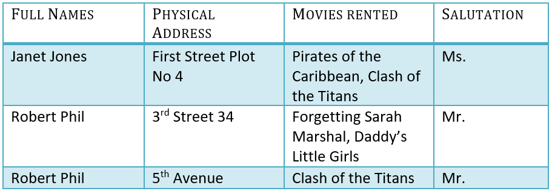
Data Normalization [and case study]
Let’s understand Normalization database with normalization example with solution:

Slide 49
Data Normalization [and normal forms]--- 1NF
1NF (First Normal Form) Rules
Each table cell should contain a single value.
Each record needs to be unique.
Usage:
Primary Key, Composite Key

Slide 50
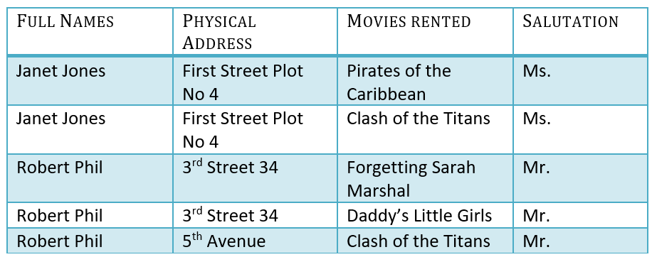
Data Normalization [and normal forms]--- 1NF

Slide 51
Data Normalization [and normal forms]---- 2NF
2NF (Second Normal Form) Rules
Rule 1- Be in 1NF
Rule 2- Single Column Primary Key that does not functionally dependent on any subset of candidate key relation

Slide 52
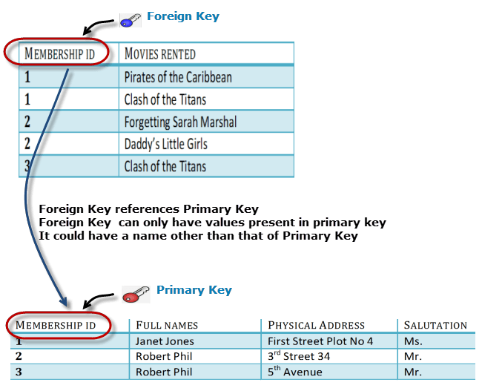
Data Normalization [and normal forms] – 2NF

Slide 53
Data Normalization [and normal forms] ---- 3NF
3NF (Third Normal Form) Rules
Rule 1- Be in 2NF
Rule 2- Has no transitive functional dependencies
We have again divided our tables and created a new table which stores Salutations.
There are no transitive functional dependencies, and hence our table is in 3NF
In Table 3 Salutation ID is primary key, and in Table 1 Salutation ID is foreign to primary key in Table 3.

Slide 54

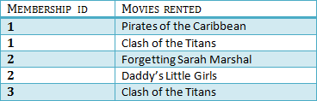

Data Normalization [and normal forms] ---- 3NF

Slide 55
Data Normalization [and normal forms]
BCNF (Boyce-Codd Normal Form) Rules
Even when a database is in 3rd Normal Form, still there would be anomalies resulted if it has more than one Candidate Key.
Sometimes is BCNF is also referred as 3.5 Normal Form.
4NF (Fourth Normal Form) Rules
If no database table instance contains two or more, independent and multivalued data describing the relevant entity, then it is in 4th Normal Form.

Slide 56
Data Normalization [and normal forms]
5NF (Fifth Normal Form) Rules
A table is in 5th Normal Form only if it is in 4NF and it cannot be decomposed into any number of smaller tables without loss of data.
6NF (Sixth Normal Form) Proposed

Slide 57
SQL JOINS [different types and its usages]
SQL JOINS [different types and its usages] SQL JOIN is a clause that is used to combine multiple tables and retrieve data based on a common field in relational databases.
SQL JOIN generates meaningful data by combining multiple relational tables.

Slide 58
SQL Inner Join

Slide 59
SQL Self Join

Slide 60
SQL Cross Join

Slide 61
SQL Outer Join

Slide 62
SQL Left Outer Join

Slide 63
SQL Right Outer Join

Slide 64
SQL Full Outer Join

Slide 65
Handling NULL Values [in SQL JOINs]

Slide 66
Best Practices [in SQL JOINs]
Here are a few important best practices to remember and apply when using SQL joins:
◆ You should always use a table alias while using the joins in the queries.
◆ Always use the two-part name [table alias].[column] name format for columns in queries.

Slide 67
Best Practices [in SQL JOINs]
◆ In the case of multiple SQL joins in a query, you should use the logical orders of the tables in such a way to satisfy your data requirement and minimize the data flow between various operators of the execution plan.
◆ You can combine multiple joins such as inner join, outer join and self-join together. However, you should use the joins and their orders to get the required data

Slide 68
Database Encryption and Decryption
Database encryption is the process of converting data, within a database, in plain text format into a meaningless cipher text by means of a suitable algorithm.
Database decryption is converting the meaningless cipher text into the original information using keys generated by the encryption algorithms.

Slide 69
Database Encryption and Decryption
The data encryption methods
Most internet security (IS) professionals break down encryption into three distinct methods:
Symmetric
Asymmetric
Hashing

Slide 70
Database Encryption and Decryption
Hashing
In terms of security, hashing is a technique used to encrypt data and generate unpredictable hash values.
It is the hash function that generates the hash code, which helps to protect the security of transmission from unauthorized users.
Hashing algorithm
provides a way to verify that the message received is the same as the message sent.
It can take a plain text message as input and then computes a value based on that message.

Slide 71
Database Encryption and Decryption
MD5
MD5 is not a reversible encryption algorithm. It's a one-way hash.
The aim of a hash is to allow you to verify (with some degree of uncertainty) whether someone had the same original information as was used to create the hash.
It does not allow you to get back from the hash to the original information.

Slide 72
Database Encryption and Decryption
INSERT INTO tbllogin(User_type_id, username, password) VALUES(2, 'rahulRam', MD5('rahul123Ram’));
SELECT * FROM tbllogin WHERE password = MD5('rahul123Ram') AND username = 'rahulRam'

Slide 73
THANK YOU

